Slide 1
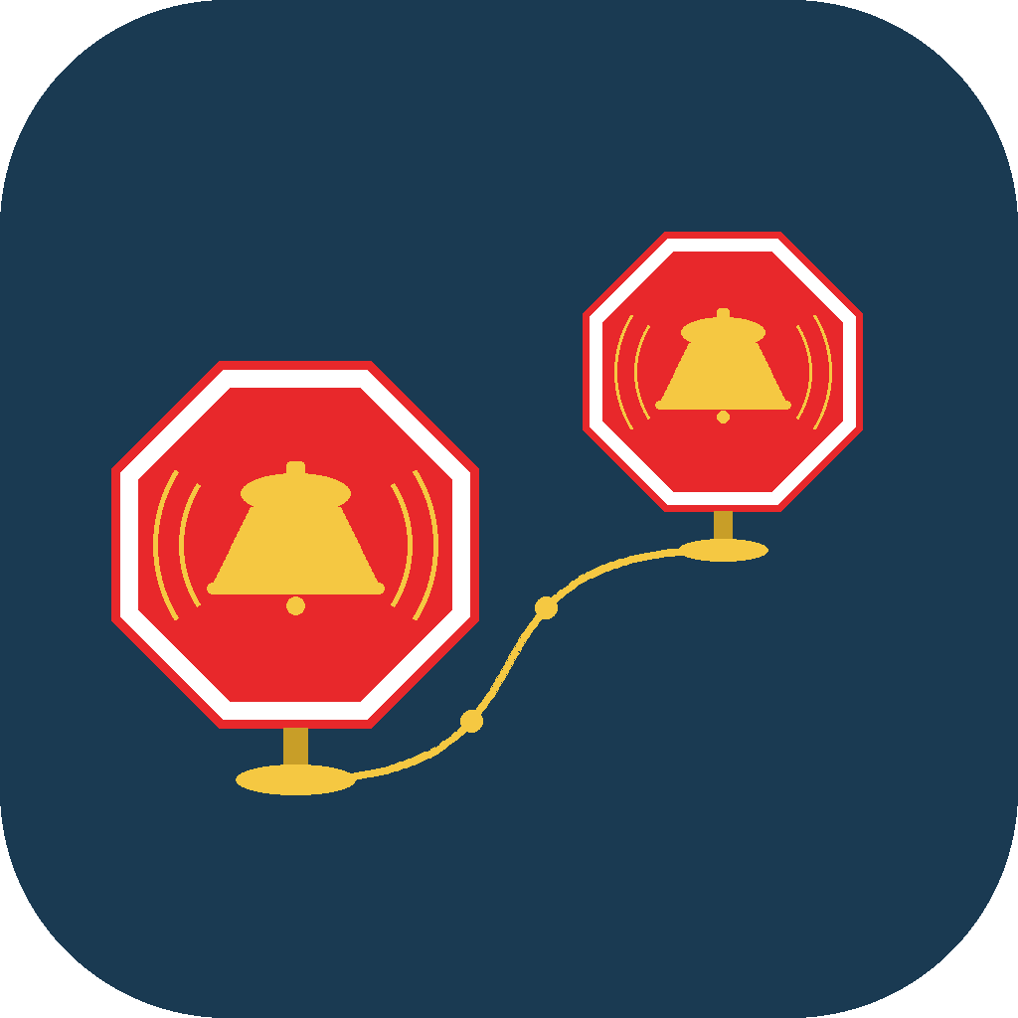
GEONAP
Wake Up Where You Need To — Not When
The alarm that knows where you're going, so you can finally relax on the way there.
For Commuters, Travelers & Anyone Who Naps On the Move
1.145-20260712

Slide 2

THE PROBLEM
Falling Asleep Feels Risky When You're Traveling
You can't count on the station. Broken departure boards, garbled PA announcements, or signage in a language you don't read make it easy to miss your stop.
Staring at a map isn't restful. Watching a blue dot inch toward your destination defeats the point of dozing off.
Time-based alarms don't know your trip. Traffic, delays, and stops all change your real arrival time — a clock alarm can't adjust.
GeoNap replaces the clock with your location — the alarm that actually knows where you're going.
GeoNap

Slide 3
HOW IT WORKS
Set It Once. GeoNap Takes It From There.
1
2
3
Pin Your Stop
Nap, Ride, Relax
Wake Up Right On Time
Drop a pin on any address, station, or transit stop — or search for it by name.
GeoNap quietly tracks your location in the background — no need to keep the app open.
A full-screen alarm fires the moment you arrive or leave — it cuts through silent mode.
GeoNap

Slide 4

CREATING AN ALARM
Pin a Spot, or Pick a Transit Stop — Your Choice
Location Alarm — search any address or drop a pin anywhere in the world, down to exact GPS coordinates.
Transit Alarm — pick your agency, route, and stop from live schedules — no coordinates needed.
Radius, your way — a simple slider sets how close you need to be before the alarm fires.
Save in seconds — name it, choose arrival or departure, and you're covered for every future trip.
Up to 20 active alarms at once on paid tiers — plenty for a daily commute plus every stop on a trip. Free tier includes one active alarm.
GeoNap

Slide 5



PEACE OF MIND
Travel Like Someone's Watching Your Stop For You
Nap Without Worry
Never Miss Your Stop
Close your eyes knowing GeoNap will wake you at your stop, every single time.
GeoNap runs on your phone's own location, not the station's screens or speakers — broken displays, garbled announcements, or signs in a language you don't read don't matter.
Keep Others in the Loop
See It All at a Glance
Auto-Notify texts friends, family, or coworkers the moment you leave or arrive — so they always know where you are on the trip, without you lifting a finger.
Every alarm shows its trigger, radius, and status right on the home screen.
GeoNap

Slide 6




SMARTER EVERY TRIP
Features That Work Quietly in the Background
Calendar Scanning
Hands-Free with Siri
GeoNap scans your calendar for upcoming trips and suggests alarms — you choose which to add.
“Create a GeoNap” sets an alarm using just your voice — no typing required.
Run Any Shortcut
Built for CarPlay
Trigger a Shortcut when you arrive — lights and heat, a text to family, even a remote car start.
Alarms appear right on your car's screen for any passenger riding along.
GeoNap

Slide 7

USE CASE
The Daily Commute, Finally Restful
Set an alarm at your station once. Every morning, doze off the moment you sit down — GeoNap wakes you just before you arrive, automatically, without setting anything twice.
USE CASE
Train & Subway
Commuters
Repeating alarms reset automatically after each trip, so the same alarm is ready again tomorrow.
GeoNap

Slide 8
USE CASE
Walk Into a Home That's Already Ready
As you approach your stop, GeoNap wakes you and can run any Shortcut at the same moment — lights on, thermostat set, and everything ready before you walk in the door.
USE CASE
Arriving
Home
Powered by any Shortcut you build — HomeKit scenes, a text to family, even a remote car start, any application that support Apple shortcuts. GeoNap just needs its name.
GeoNap

Slide 9

USE CASE
Never Miss the Bus Again
Set a departure alarm at your home stop. GeoNap fires the moment you leave the area — a built-in reminder to head out, right when you need it.
USE CASE
Bus
Riders
Choose On Departure as the trigger, and pair it with a comfortable radius for your stop.
GeoNap

Slide 10
USE CASE
Ride Along Without Watching the Map
Set an alarm at a waypoint city or your final destination. You'll be notified the moment the car gets close — so you can read, nap, or chat instead of tracking every mile.
USE CASE
Road Trip
Passengers
Time-based triggers can even wake you a set number of minutes before arrival, based on your current speed.
GeoNap

Slide 11

USE CASE
Confidence in Any New City
Set alarms at your hotel, airport, or meeting locations so you always know the moment you're getting close — even somewhere you've never been.
USE CASE
Travelers
Abroad
GeoNap works fully offline for standard alarms, and is available in 13 languages.
GeoNap

Slide 12

USE CASE
Know They're On Their Way — and Home Safe
Turn on Auto-Notify for any alarm and the people who care get a text the moment you leave and the moment you arrive — a parent tracking a teenager's commute, or family waiting to hear you landed safe.
USE CASE
Family &
Friends
Auto-Notify fires on both On Departure and On Arrival triggers, so both ends of every trip are covered automatically.
GeoNap

Slide 13

BUILT FOR REAL TRIPS
Two Ways an Alarm Knows When to Fire
Distance — fires the moment you cross a set radius from your pin. Ideal for a fixed stop like a single station.
Time before arrival — fires a set number of minutes before you get there, based on your travel speed — perfect for “wake me 5 minutes before my stop.”
Every radius, adjustable — 200 m suits a single station; 500–1,000 m gives extra time near a town center or airport.
Time mode is ideal for napping on a train or bus — it adapts to how fast you're actually moving.
GeoNap

Slide 14

GO ANYWHERE
Worldwide Transit, In Your Language
Preloaded agencies — Amtrak, BART, MBTA, CTA, GO Transit, and more, ready out of the box.
Any public feed — add any transit agency worldwide with a public GTFS feed URL.
13 languages — English, Spanish, French, German, Italian, Portuguese, Arabic, Hindi, Japanese, Simplified Chinese, Russian, Thai, and Vietnamese.
Bundled travel sounds — boat horn, cable car bell, steam train, sailboat bell, airplane landing, airport chime, or vibrate only.
GeoNap

Slide 15

BUILT ON TRUST
Your Location. Your Calendar. Your Control.
Calendar data is read entirely on your device and never uploaded or shared.
Calendar Scanning is off by default — you turn it on, and you choose which calendars to include.
Every suggested alarm is reviewed by you first; nothing is added automatically.
Full disclosure of how location data is handled is always one tap away in Settings.

Slide 16
YOUR DATA, YOUR CONTROL
Privacy at a Glance
Location
Auto-Notify Contacts
Processed entirely on your device — never sent to any server I operate, and kept only as long as needed to trigger your alarm.
Only the contact(s) you pick via Apple’s contact picker — just a name and phone number or email. No bulk access to your address book.
Apple Watch
Diagnostics
Alarms sync device-to-device via WatchConnectivity and live in a local App Group on your Watch — never synced to iCloud from the Watch.
Crash and error logging happens entirely on-device via Apple’s own OSLog — no third-party crash SDK, nothing ever leaves your device.

Slide 17
AVAILABILITY
Where GeoNap Runs
Device | Requirement
iPhone | iOS 26.0 or later
iPad | iPadOS 26.0 or later
Apple Watch | watchOS 26.0 or later (companion features)
Car Play / Apple Shortcuts | Supported
Connectivity | Offline for standard alarms; internet needed only for transit feed downloads
Location Services must be set to Always so alarms can fire in the background.
GeoNap

Slide 18
PRICING
Simple Plans for Every Traveler
Plan | What's Included
Free $0 | Location alarm only (no support for time based or Transit alarm creation) One active alarm (distance-based) Default alarm sounds
Silver $2.99 / year | Everything in Free, plus: Unlimited simultaneous alarms (Location only) Full sound library Contact notify (prompted SMS) Control over alarm active time windows
Gold $6.99 / year | Everything in Silver, plus: Time-based alarms Transit agency integration + caching Hands-free Auto-SMS / Notify Contacts Repeat & per-day scheduling
Platinum $12.99 lifetime | Everything in Glod, plus: Calendar-scan auto-scheduling Live alarms, see distance/ETA progress tied to your GPS position Priority transit feed support Full integration support with other Apps that support Shortcuts + enhanced Dead Reckoning for Time-based alarms.
Prices shown in USD.
GeoNap

Slide 19
Never Miss Your Stop Again
Set your first location alarm in under a minute — and nap the whole way there.
Download GeoNap (iOS device) **
** GeoNap is available in test mode only. As such, Apple requires installation of an app “TestFlight” on their local iOS device. GeoNap installation, upgrades and feedback is done using the TestFlight application.

